Slide 1
Classification Model (Predict Which Customer Will Have Default Payment Next Month)
Done By: Toh Kien Yu (P2222291)

Slide 2
Roadmap
Nature Of Datasets
Data Exploration
Data Preprocessing
Algorithms Used
Test And Score (Before Tuning)
Hyperparameter Tuning
Test and Score (After Tuning)
Feature Importance
Dummy Baseline
Conclusion

Slide 3
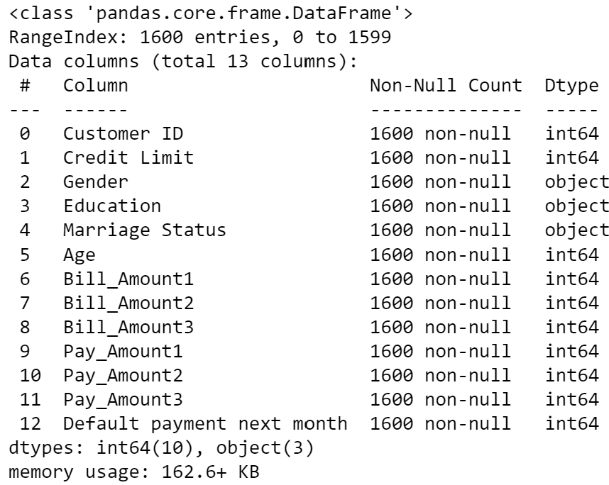
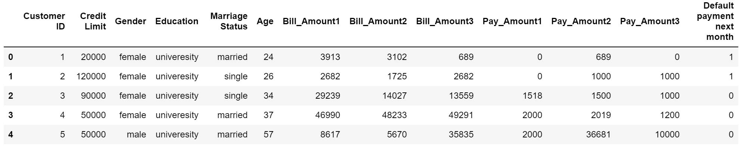
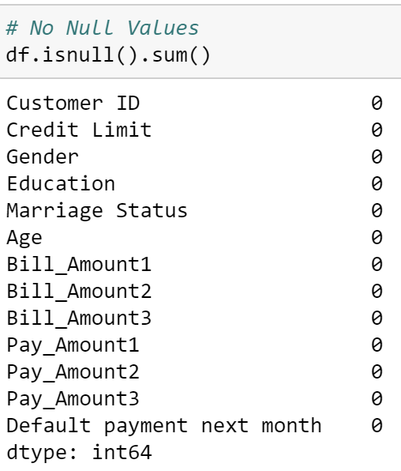
Nature of Dataset
(1600 rows, 13 columns)
Categorical Data
Gender (female, male)
Education (‘univeresity’, post-graduate, high school)
Marriage Status (married, single,)
Default payment next month (0 = non default, 1 = default)
Numeric Data
Customer ID
Credit Limit
Age
Bill_Amount1 (credit card bill amount 1 month ago)
Bill_Amount2 (credit card bill amount 2 month ago)
Bill_Amount3 (credit card bill amount 3 month ago)
Pay_Amount1 (the amount customer paid 1 month ago)
Pay_Amount2 (the amount customer paid 2 month ago)
Pay_Amount3 (the amount customer paid 3 month ago)

Slide 4
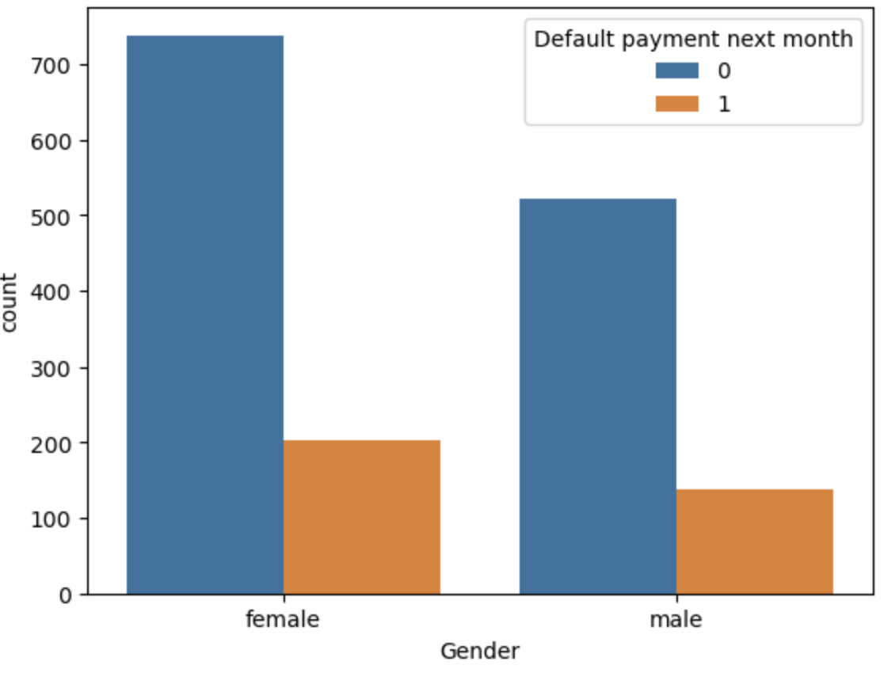
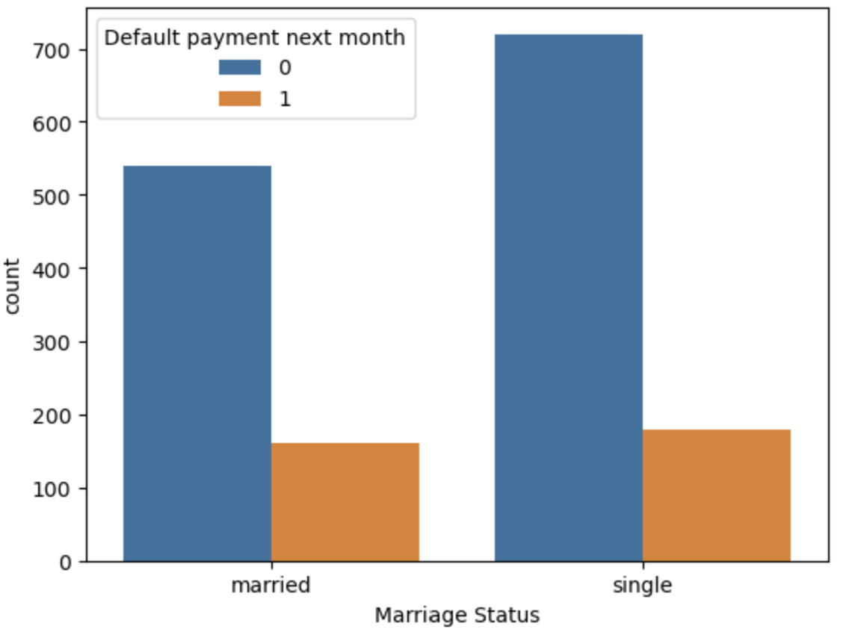
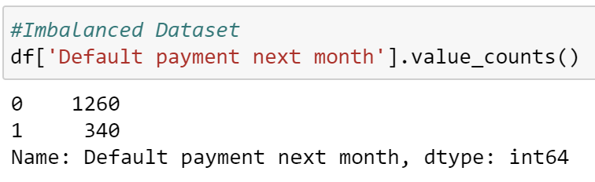
Data Exploration
From the graph, there is more non defaulting payment than defaulting
From the graph, singles are more likely to non-default payments
Note: Imbalanced dataset

Slide 5
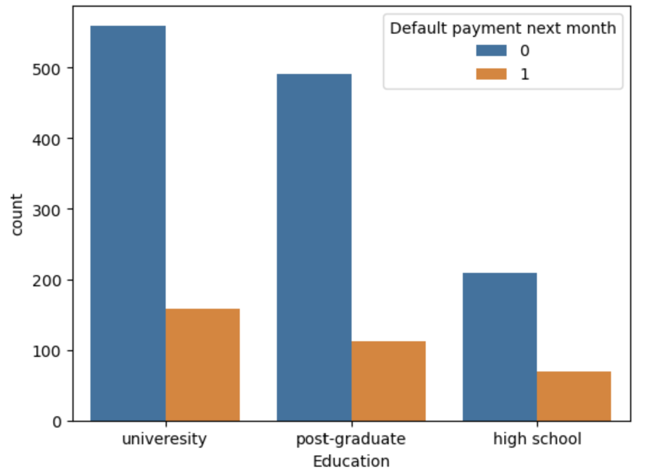
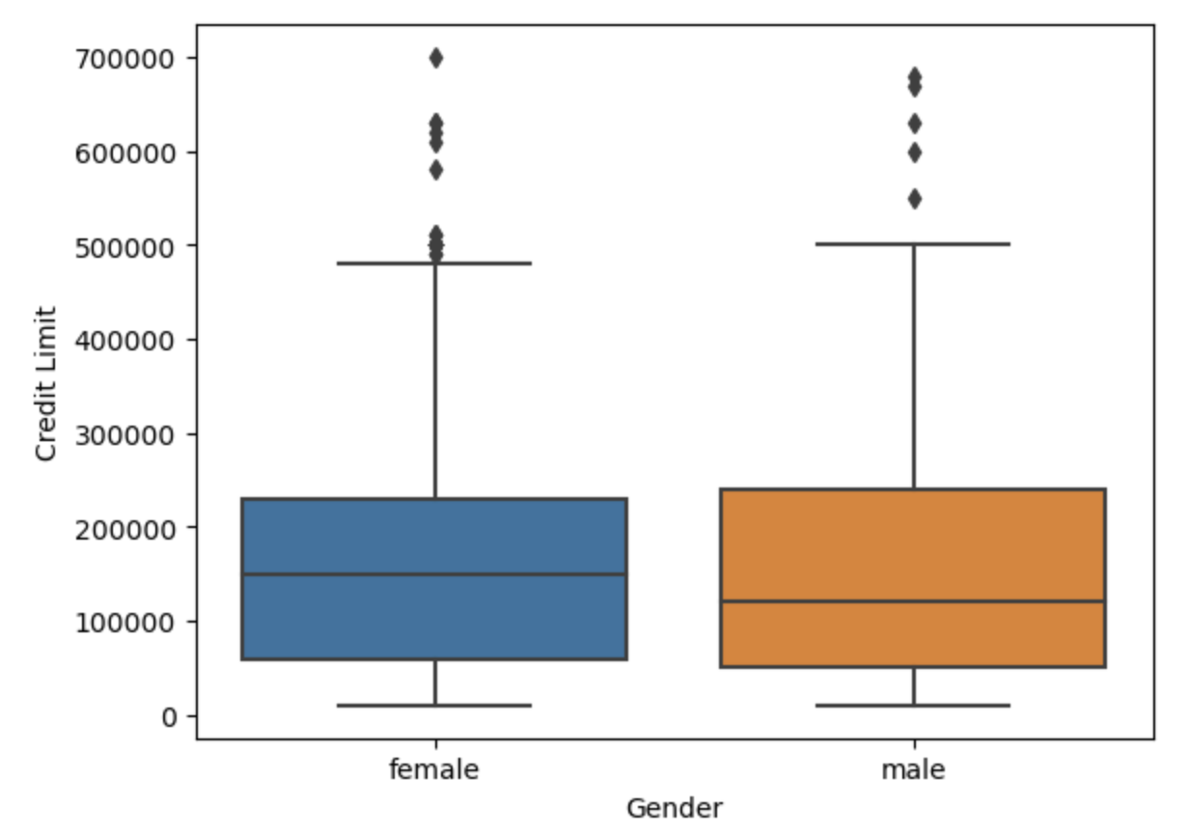
Data Exploration
There are more non defaulting payments than those defaulting payments
From the box and whisker graph, female have a higher median credit limit than male.

Slide 6
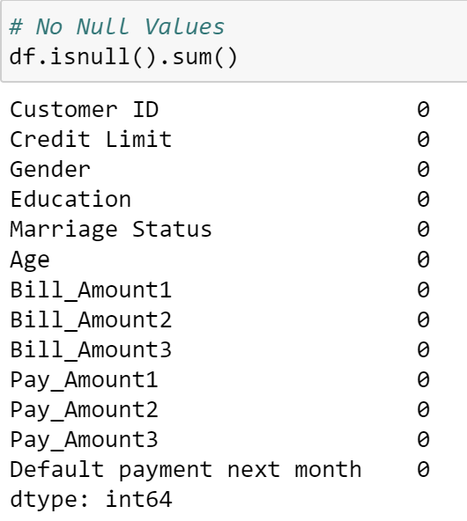
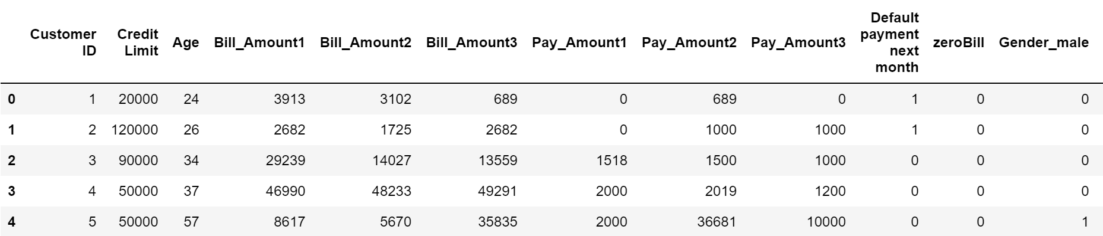
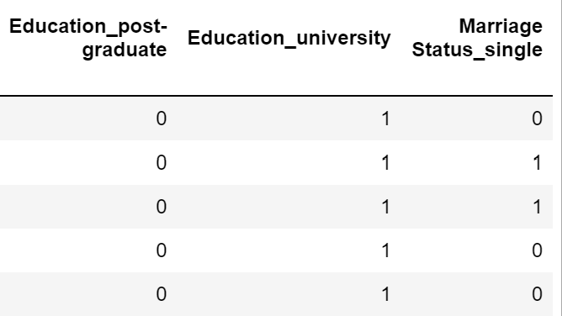
Data Preprocessing
1. Renaming Typo Error
2. Encoding Categorical Variables
Imputation is not needed
Result:

Slide 7
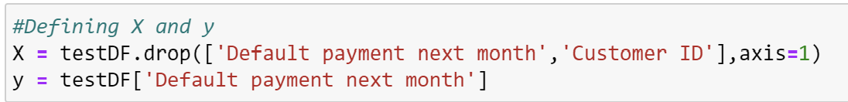
Feature Engineering & Feature Selection
Feature Engineering
Feature engineer is the process to create additional relevant features from the existing raw features of the data to improve the learning algorithm. ‘zeroBill’ is created to sieve out those people who do not have a bill at the end of the month.
Feature Selection
Feature Selection is done to get rid of features that are redundant by taking the best subset of the dataset.
X drops the target variable (‘Default payment next month’) and identifying column (‘Customer ID’).
y is the target variable
(‘Default payment next month’)

Slide 8
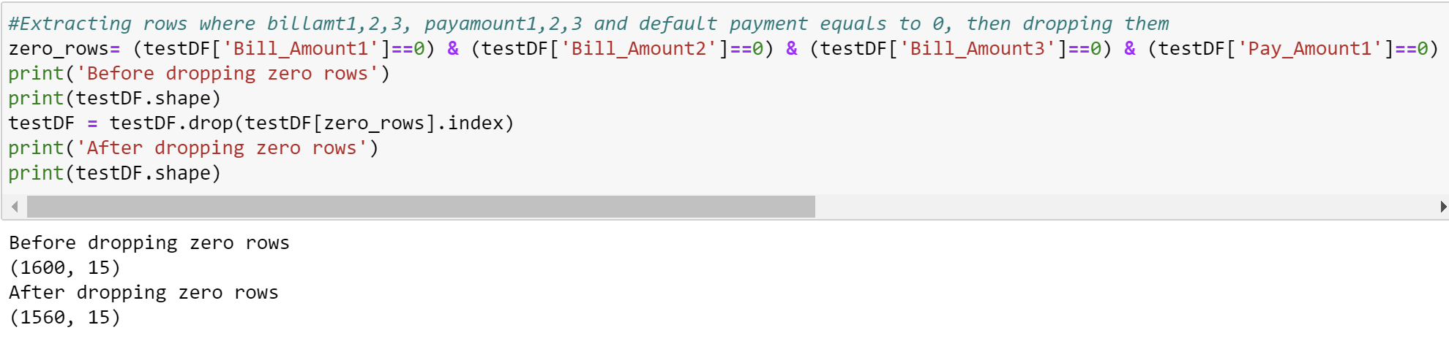
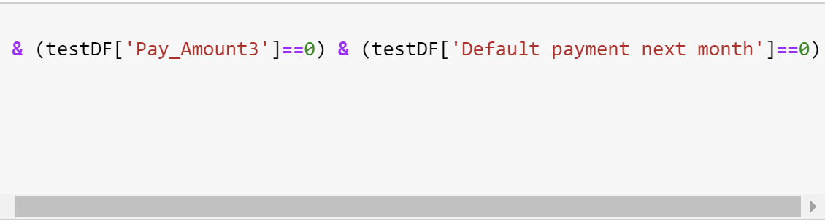
Feature Engineering & Feature Selection
Rows that contain ‘0’ for Bill_Amount1, , Bill_Amount2, Bill_Amount3, Pay_Amount1, Pay_Amount2, Pay_Amount3, Default payment next month are all dropped as people who do not have bills will naturally non default payment. Hence, improving the model’s accuracy.

Slide 9
Algorithms Used
Logistic Regression
Gradient Boosting Classifier
Random Forest
GaussianNB
HistGradientBoosting Classifier
Logistic Regression
Predict binary variable/likelihood of an event (0 = ‘non default’, 1 = ‘default’ )
Handles categorical variable.
Performs well in smaller dataset (1600 Rows, 13 Columns).
Easy to implement.
Low bias and high variance
Random Forest
Good predictions that can be easily understood over decision trees.
Reduces overfitting by averaging multiple decision trees.
Not sensitive by outliers.
HistGradientBoosting Classifier
Histogram Based Gradient Boosting
Able to handle numeric and categorical variable
Able to recognize complex patterns which results in more accurate prediction
Gradient Boosting Classifier
One of the most powerful algorithms in machine learning
Good at decreasing the bias error.
A variety of options to choose from when hyperparameter tuning
GaussianNB
Easy to Implement
Fast predictions
Easy to understand algorithm
Can predict well with less data
Higher bias and low variance

Slide 10
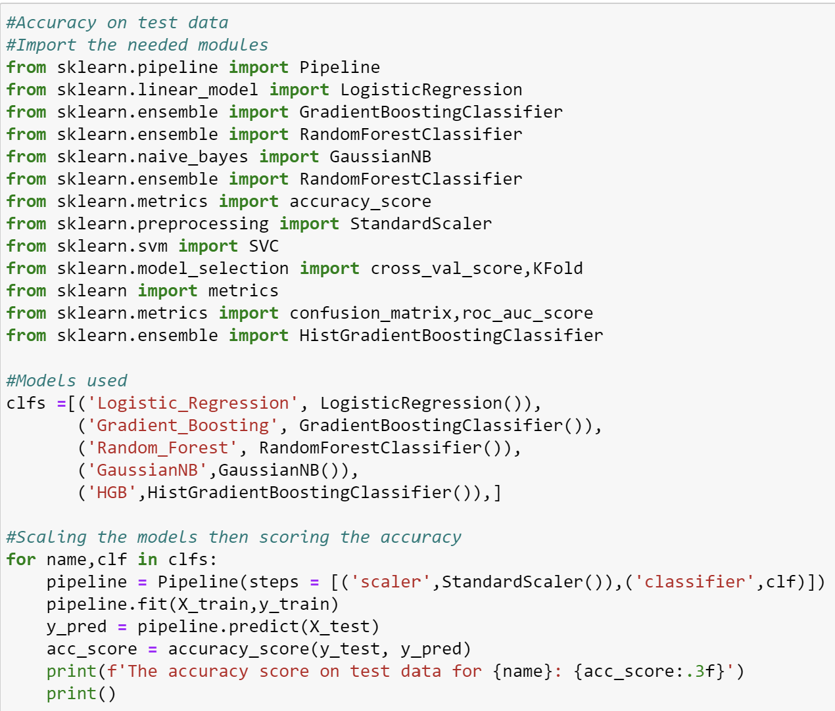
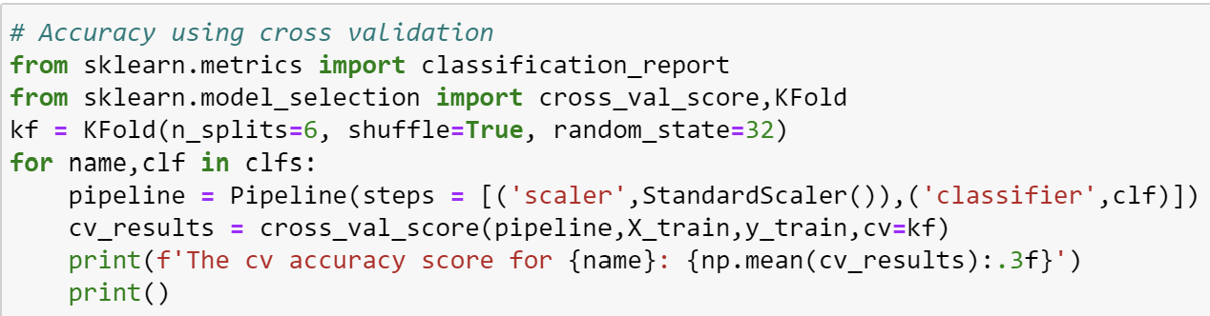
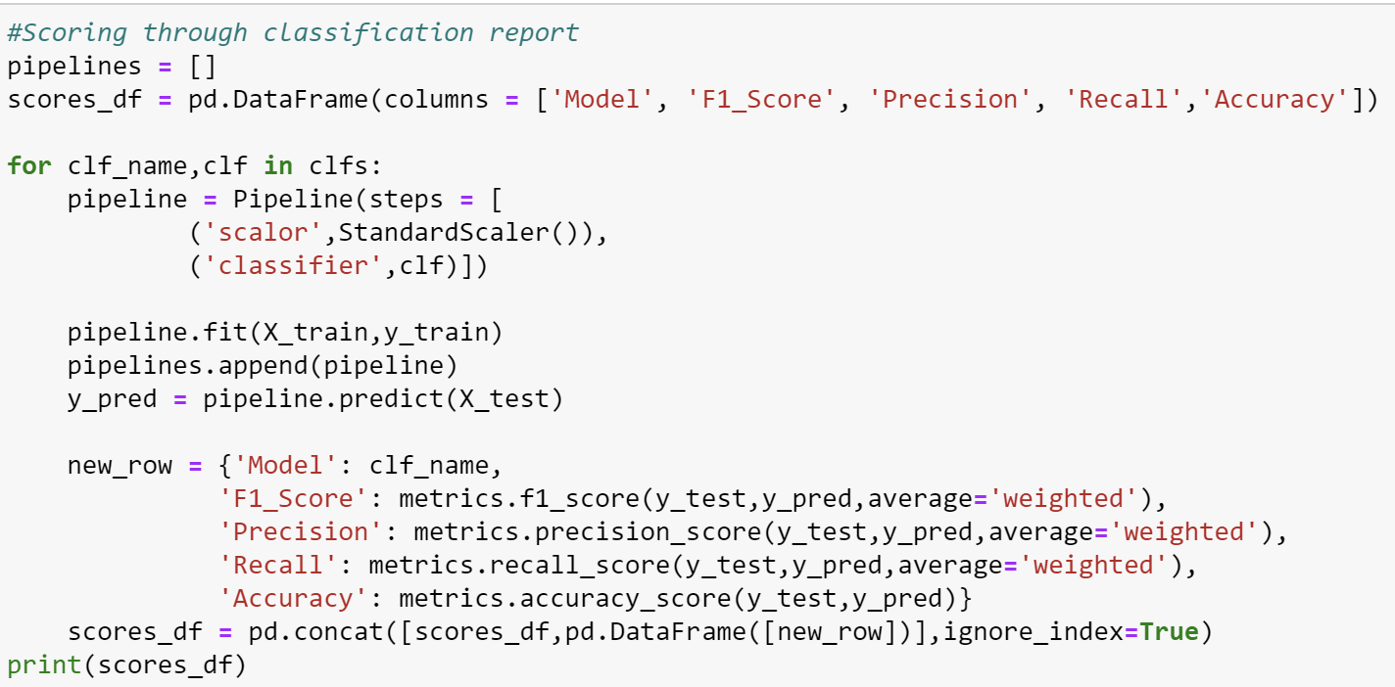
Test and Score Code (Before Hyperparameter Tuning)

Slide 11
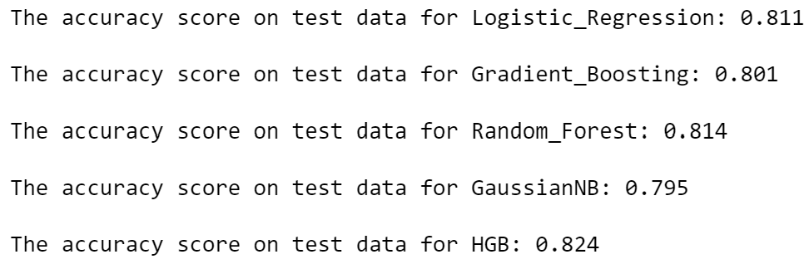
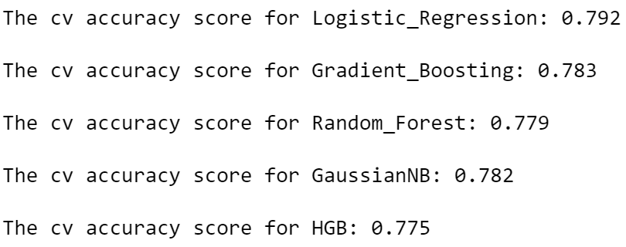
Test and Score (Before Hyperparameter Tuning)
Split To Test and Train Data
An 80:20 ratio between training and test data is chosen where 80% of the data is for training and 20% is for testing.
Accuracy On Test Data
Cross Validation Accuracy Score
Random Forest Algorithm has a highest Accuracy Score of 0.814 compared to the other algorithms. This tells us that the model is good at making accurate predictions on the likelihood of an ‘unseen’ person that will default payment
Gaussian Naïve Bayes Algorithm has a highest Cross Validation Accuracy Score of 0.782 compared to the other algorithms. This tells us that the model making accurate prediction 78% of the time

Slide 12
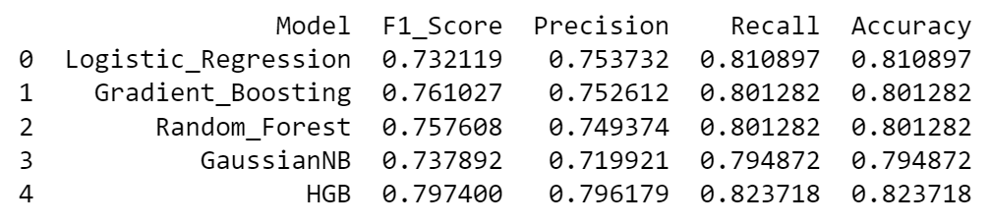
Test and Score (Before Hyperparameter Tuning)
Classification Report
HGB Algorithm has a highest F1 Score of 0.797 compared to the other algorithms.
This tells us that the model have high precision and recall.
In turn, the algorithm is able to produce more relevant results which also leads to higher performance.
From the 3 test and score results obtained,
Random Forest has the highest accuracy on test data.
Gradient Boosting has the highest cross validation accuracy score
HGB has the highest F1 Score

Slide 13
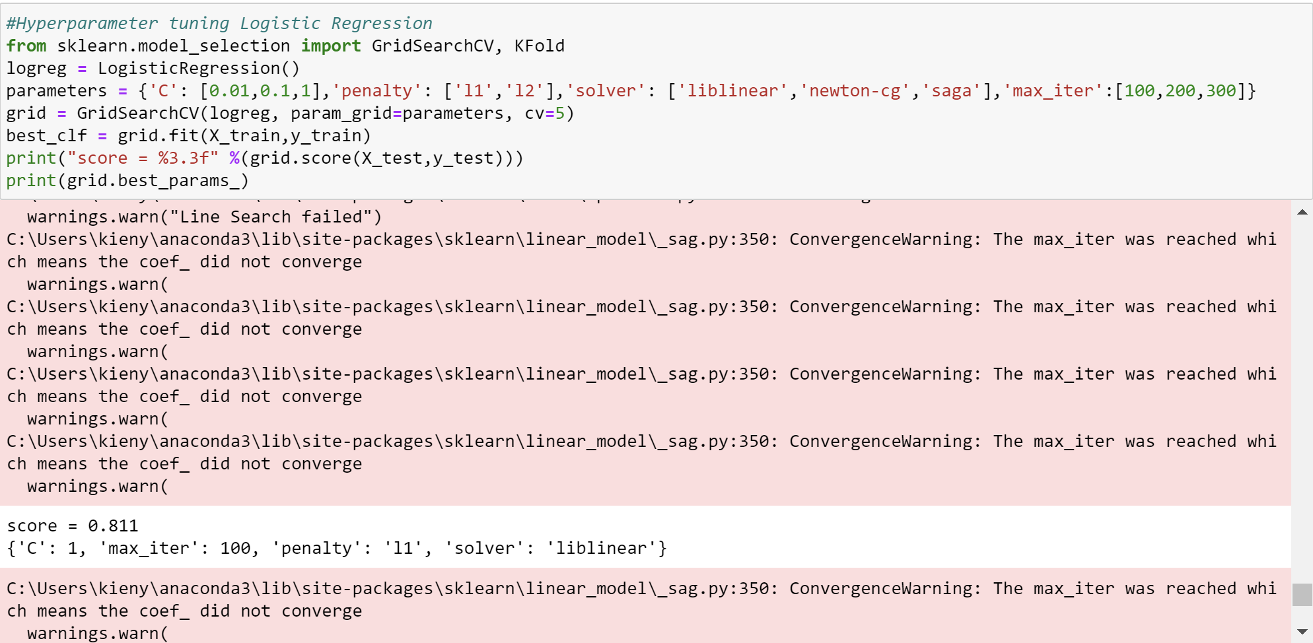
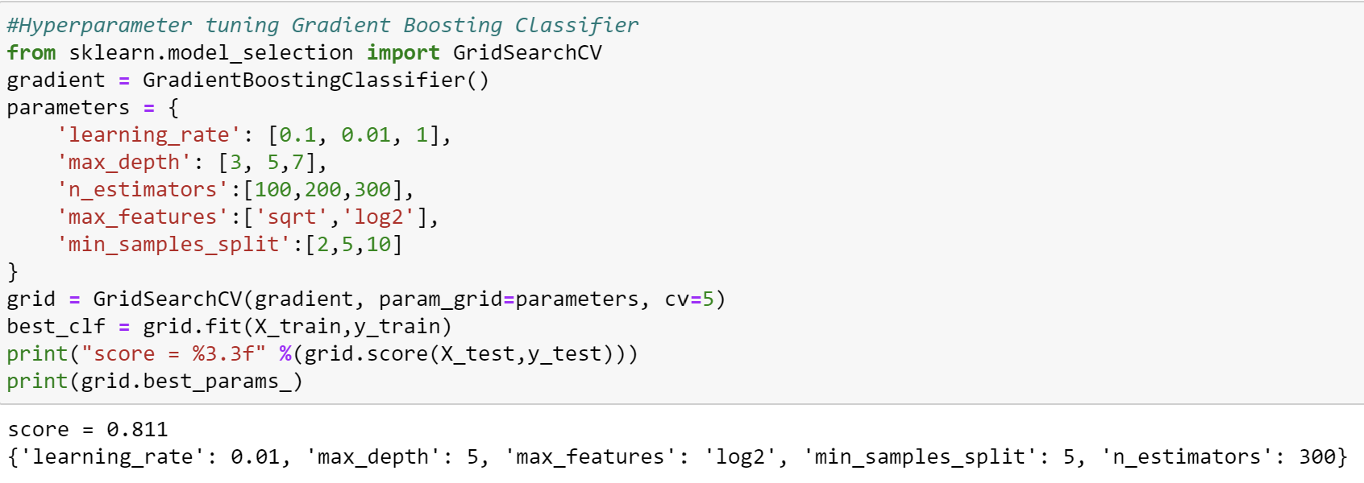
Hyperparameter Tuning
Now, I will hyperparameter tune the model to further improve the accuracy by customising the parameters for the algorithm.
Define a param grid for each model, and parameters I would like to test
GridSearchCV will loop through all the different types of combinations.
Upon looping through all the combinations, it will provide me with the best parameter combinations and highest score obtained.

Slide 14
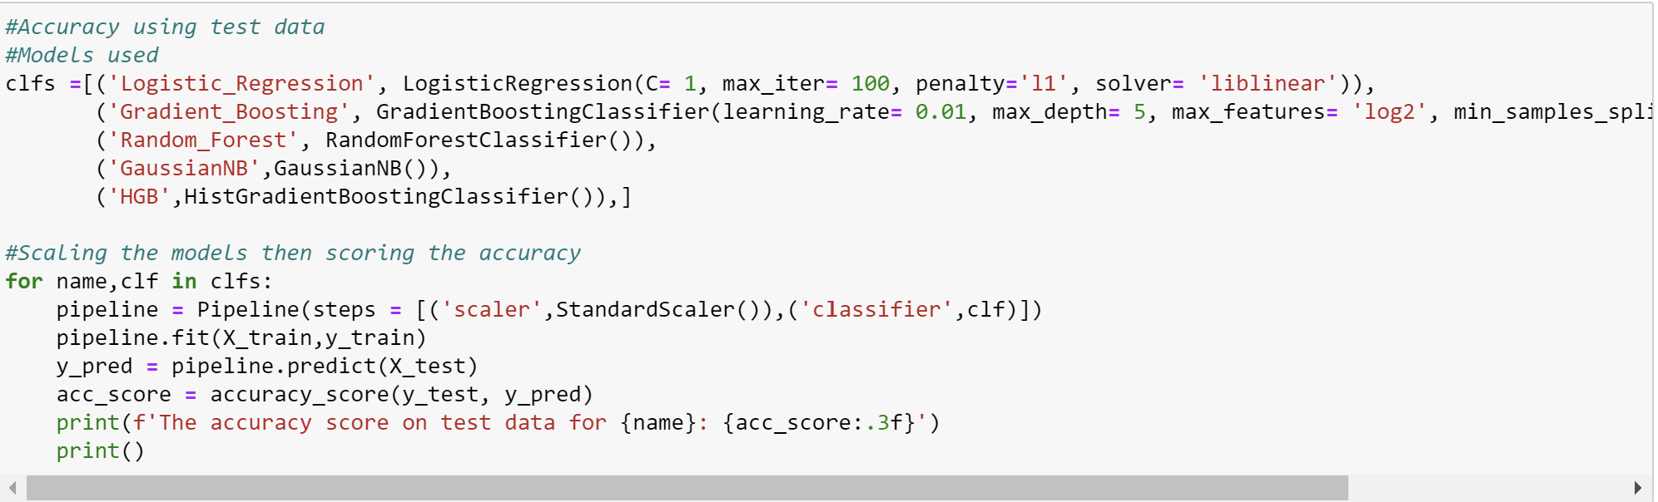
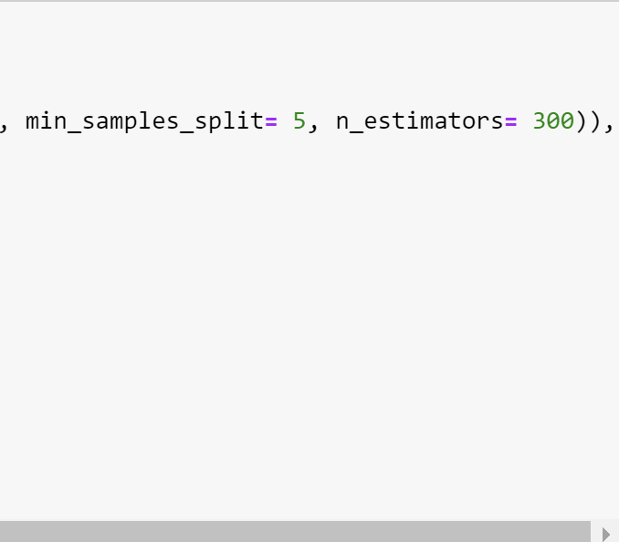
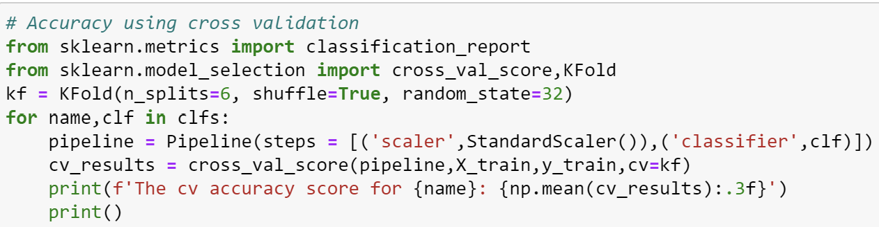

Test and Score Code (After Hyperparameter Tuning)

Slide 15
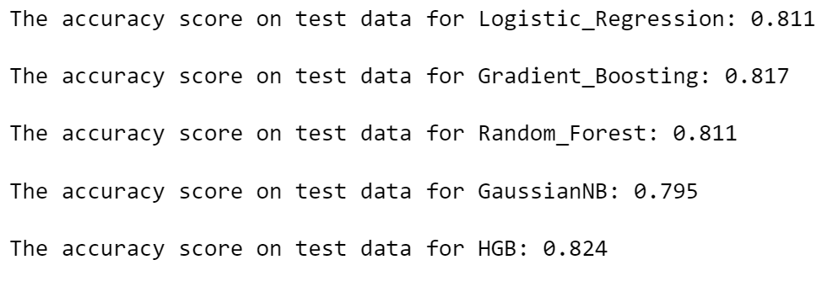
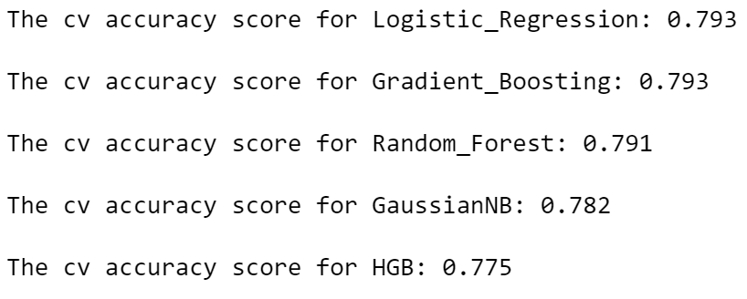
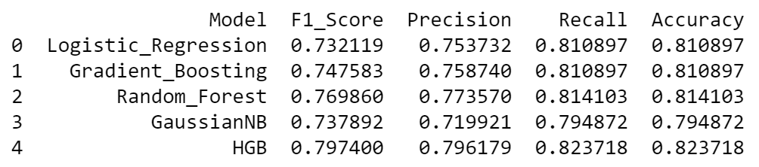
Test and Score (After Hyperparameter Tuning)
Accuracy On Test Data
Cross Validation Accuracy Score
Classification Report
After tuning the models,
Gradient Boosting Accuracy on Test Data increased from 0.801 to 0.811 and cross validation score increased from 0.783 to 0.793.
Logistic Regression’s Accuracy on Test Data remained stagnant while the cross-validation accuracy score only increased by 0.01.
Overall, hyperparameter tuning is not as effective for my classification model.

Slide 16
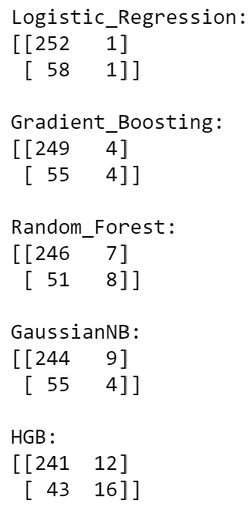
Evaluation
From the 5 algorithms chosen, all algorithms are able to give good accurate predictions on whether one will default payment.
However, Logistic Regression and Gradient Boosting stood out among the rest
Logistic Regression algorithm is able to correctly predict and classify 252 people as ‘non-default’ while incorrectly predicting 1 person as ‘default’.
As well as correctly predicting and classifying 1 person as ‘default’ while incorrectly predicting 58 people as ‘non-default’
HistGradientBoosting algorithm is able to correctly predict and classify 241 people as ‘non-default’ while incorrectly predicting 12 person as ‘default’.
As well as correctly predicting and classifying 16 person as ‘default’ while incorrectly predicting 43 people as ‘non-default’
Imbalanced dataset will result in the model being bias towards the majority class.
This will result in the model accurately predicting ‘non default’ more and not as accurate when predicting ‘default’.
Confusion Matrix
From the confusion matrix, it tells us that the model is very good at predicting if one will not default payment but is not as good at predicting if one will default payment.
This is further strengthened by the point that the dataset is imbalanced.

Slide 17
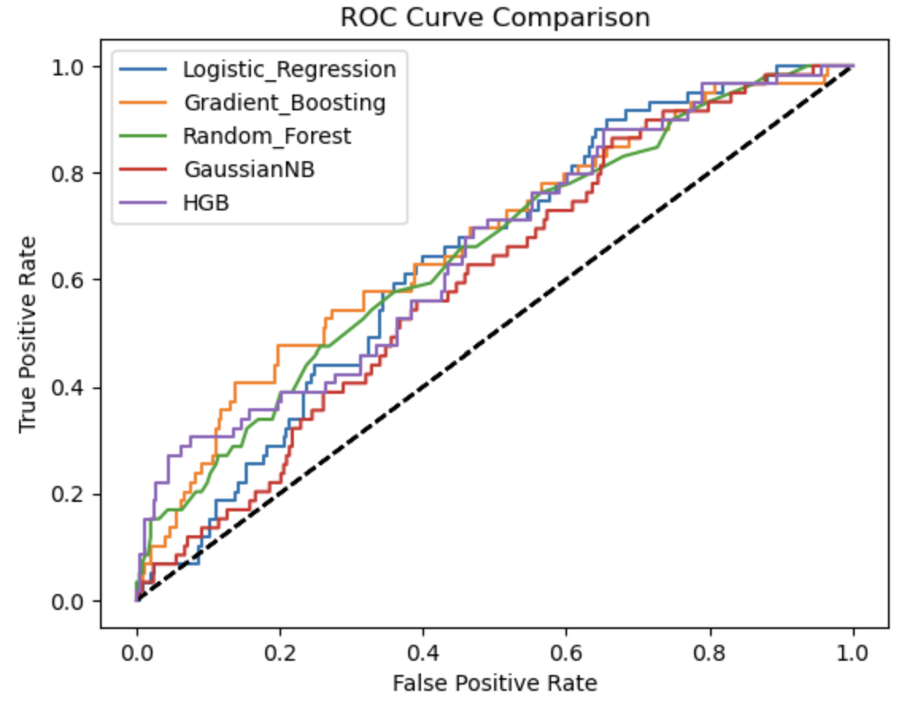
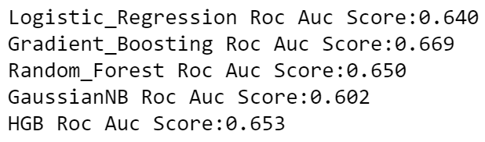
Evaluation

Slide 18
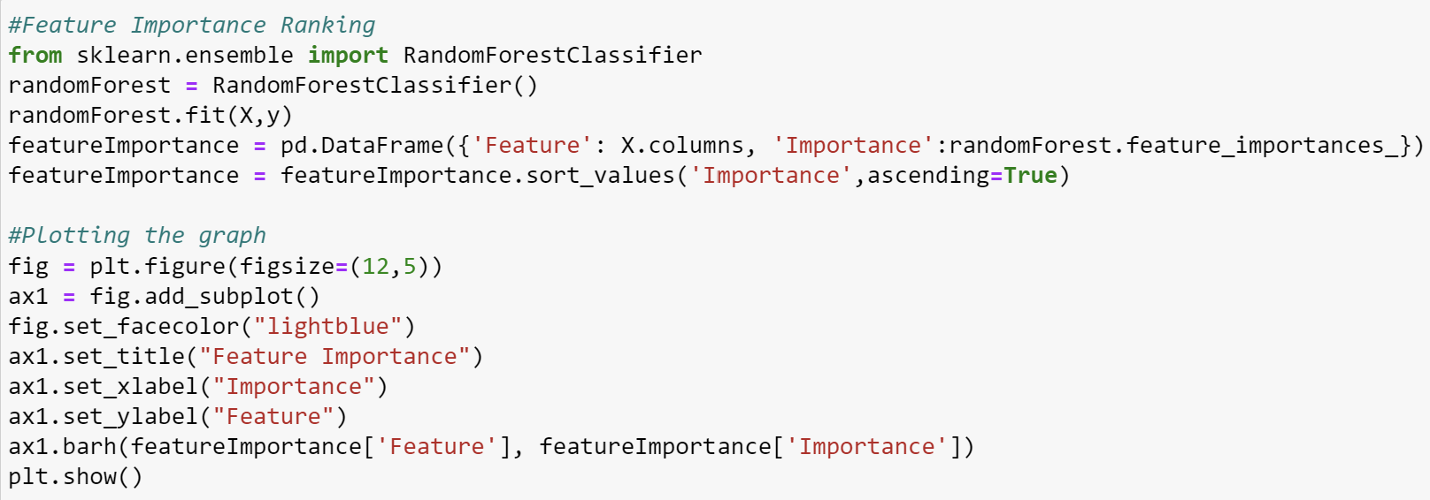
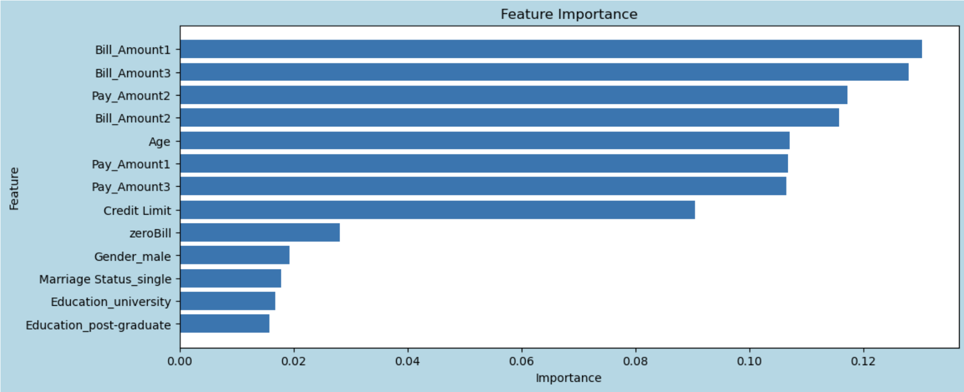
Feature Importance Graph Code

Slide 19
Feature Importance
Feature Importance
The feature importance graph shows that:
The model relies heavily on the bill amount to predict if one will default payment.
The model relies on the education the least when predicting if one will default payment
This also means that bill amount strongly correlates if one will default payment

Slide 20
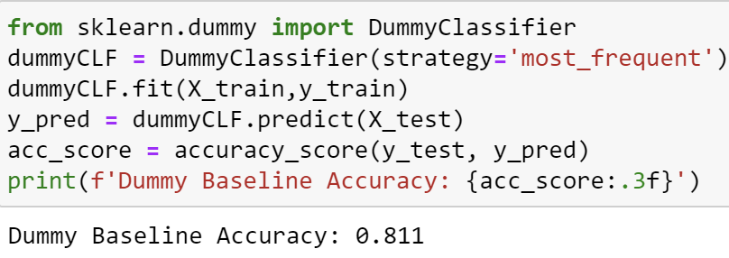
Dummy Baseline
As compared to a dummy baseline, my model accuracy increased, my model is able to capture patterns in the data and make more accurate predictions.

Slide 21
Conclusion
In Conclusion, this dataset has given me a deep understanding on the likelihood of one defaulting payment.
Upon considering all 3 different accuracy reports HistogramGradientBoosting is my most accurate model to predict if one will default payment.

Slide 22
Thank You!

